Slide 1
Protective devices and basic tools
Tom Pankonen
Honey Pimp Apiaries

Slide 2
Protection
There is no sting proof suit!
You’re going to get stung
Take your time and pay attention
Focus on the bees; put your other concerns aside for a bit

Slide 3
Protective Gear
Suit?
Jacket?
Veil?
Gloves?
EpiPen

Slide 4
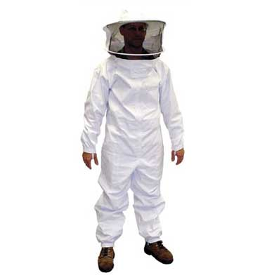
suit
Dadant.com

Slide 5
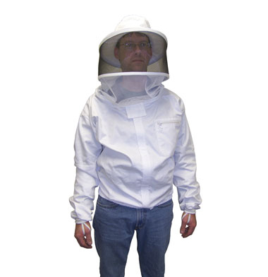
Jacket
Dadant.com

Slide 6
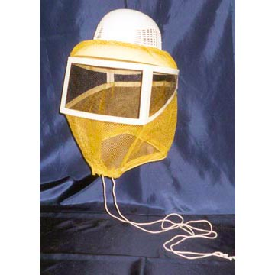
veil
Dadant.com

Slide 7
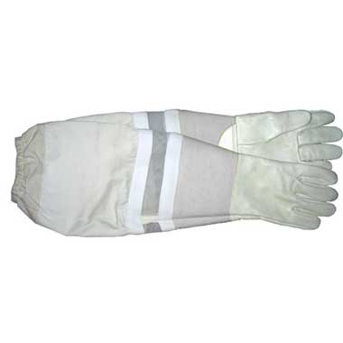
Gloves
Dadant.com

Slide 8
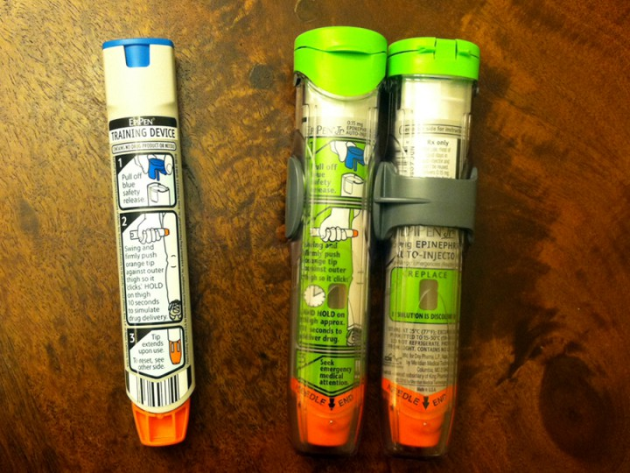
Epipen
marketingmama.com

Slide 9
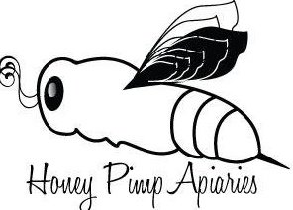
Basic tools
Smoker
Hive tool
Frame grip
Brush

Slide 10
smokers
Steel or stainless steel?
Shielded?
Plug or cork
Storage
Fire extinguisher

Slide 11
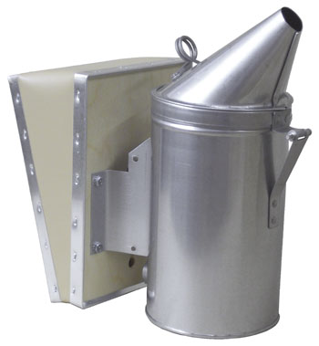
UnshiElded smoker
Dadant.com

Slide 12
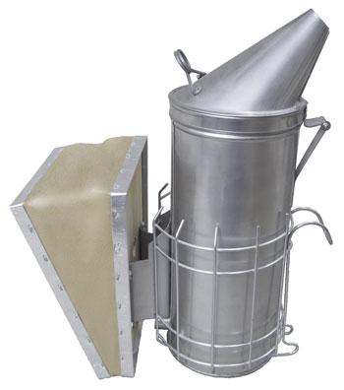
shiElded smoker
Dadant.com

Slide 13
Hive tools
Why?
Size?
Cleaning?
Spreading disease?

Slide 14
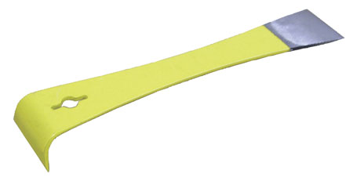
Hive tool
Dadant.com

Slide 15
Frame grip
Required?
When to use?

Slide 16
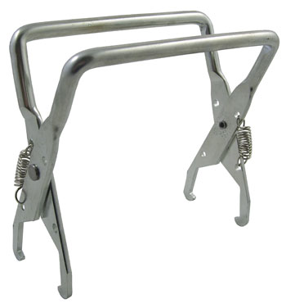
Frame grip
Dadant.com

Slide 17
brush
Why?
When?

Slide 18
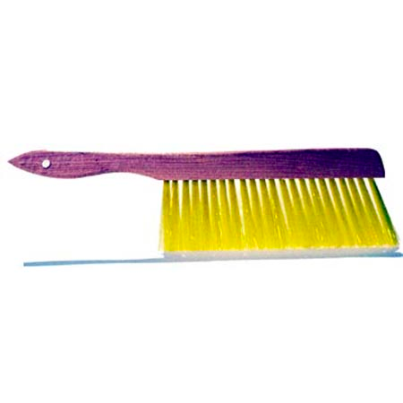
Bee brush
Dadant.com

Slide 19
Other handy stuff
Propane torch
Buckets
Spare hive tools
Smoker fuel

